Slide 1
Python Programming
CSCI 5521
Introduction to Machine Learning

Slide 2
Python IDE
PyCharm is highly recommended:
code completion
code inspection
on-the-fly error highlighting
quick fix
…
Availability
https://www.jetbrains.com/pycharm/
The professional edition is free for the University community, sign up with UMN email account to get license.
Notes:
Python is a high-level, dynamically typed multiparadigm programming language. Python code is often said to be almost like pseudocode, since it allows you to express very powerful ideas in very few lines of code while being very readable. IDE (Integrated Development Environment).

Slide 3
Installing Python
Python 3.6 is preferred
If you have already installed Python, please check your Python version
type “python --version” in terminal to make sure you have 3.6
Several ways to install Python
Anaconda (Recommended for all platform)
Linux: https://repo.continuum.io/archive/Anaconda3-5.2.0-Linux-x86_64.sh
Mac: https://repo.continuum.io/archive/Anaconda3-5.2.0-MacOSX-x86_64.pkg
Windows: https://repo.continuum.io/archive/Anaconda3-5.2.0-Windows-x86_64.exe
Standalone Python via command line tools (Unix-like system)
apt (Ubuntu or Debian)
homebrew (Mac)
Standalone Python via installer (Windows system)
https://www.python.org/downloads/release/python-365/
PyCharm users follow the below link to configure Python interpreter for both new project and existing project if Python 3.6 isn't default interpreter (using conda is preferred).
https://www.jetbrains.com/help/pycharm/configuring-python-interpreter.html
Notes:
Anaconda is basically a distribution of Python for scientific computing, and aims to simplify package management and deployment. It ships with most packages (including Numpy, Scipy and Matplotlib) which are heavily used in this course.
There are currently several different supported versions of Python, 2.7, and 3.x. Somewhat confusingly, Python 3.0 introduced many backwards-incompatible changes to the language, so code written for 2.7 may not work under 3.x and vice versa. For this class all code will use Python 3.6.

Slide 4
Python Packages
Several ways to install Python packages
PyCharm GUI (Recommended)
https://www.jetbrains.com/help/pycharm/installing-uninstalling-and-upgrading-packages.html
conda (Recommended for CSE-lab computers)
conda install <package-name>
conda install <package-name>=<package-version>
pip (Default Python package management)
pip install “<package-name>”
pip install “<package-name>=<package-version>”
Notes:
Conda is a package management system and environment management system that runs on all platform. It quickly installs, runs and updates packages and their dependencies, and manages the isolate environments for different projects.
Pip is only a package management system, and needs additional packages to get environment managing function.

Slide 5
Basic data types and operations
Numbers
Integers and floats
x = 3
y = 2.5
print(type(x), type(y)) #prints “<class ‘int’>” and “<class ‘float’>”
print(x+1, x-1, x*2, x**2) # addition prints”4”; subtraction prints “2”; multiplication prints ”6”; exponentiation prints “9”
x += 1
print(x) # prints “4”
x *= 2
print(x) # prints “8”
print(y, y+1, y*2, y**2) # prints “2.5 3.5 5.0 6.25”
Note that Python doesn’t have x++ or x-- operators.
Notes:
Like most languages, Python has a number of basic types including integers, floats, booleans, and strings. These data types behave in ways that are familiar from other programming languages.
Python does not have unary increment (x++) or decrement (x--) operators.

Slide 6
Basic data types and operations
Booleans
t = True
f = False
print(type(t), type(f)) # prints “<class ‘bool’>”
print(t and f) # logical AND prints “False”
print(t or f) # logical OR prints “True”
print(not t) # logical NOT prints “False”
print(t != f) # logical XOR prints “True”
Notes:
Python implements all of the usual operators for Boolean logic, but uses English words rather than symbols (&&, ||, etc.).

Slide 7
Basic data types and operations
Strings
str1 = ‘hello’ # both single and double quotes
str2 = “world” # can indicate strings
print(str1) # prints “hello”
print(len(str1)) # prints string length, “5”
str3 = str1 + ‘ ’ + str2 # string concatenation
print(str3) # prints “hello world”
str4 = ‘%s %d’ % (str3, 4) # sprint style string formatting
print(str4) # prints “hello world 4”

Slide 8
Advanced data types and operations
Lists
lst = [3, 1, 2] # create a list
print(lst, lst[2]) # indexing prints “[3, 1, 2] 2”
print(lst[-1]) # reverse indexing prints “2”
lst[2] = ‘foo’ # lists can contain elements of different type
print(lst) # prints “[3, 1, ’foo’]”
lst.append(‘bar’) # add new element to the end of the list
print(lst) # prints “[3, 1, ‘foo’, ‘bar’]”
ele = lst.pop() # remove and return the last element of the list
print(ele, lst) # prints “bar [3, 1, ‘foo’]”
Notes:
A list is the Python equivalent of an array, but is resizeable and can contain elements of different types

Slide 9
Advanced data types and operations
Slicing on lists
lst = list(range(5)) # range creates a list of integer
print(lst) # prints “[0, 1, 2, 3, 4]”
print(lst[2:4]) # get a slice from 2 to 4 (exclusive) prints “[2, 3]”
print(lst[2:]) # get a slice from 2 to the end prints “[2, 3, 4]”
print(lst[:2]) # get a slice from the start to 2 (exclusive) prints “[0, 1]”
print(lst[:]) # get a slice of whole list prints “[0, 1, 2, 3, 4]”
print(lst[:-1]) # use reverse indexing, get a slice from the start to the last element (exclusive) prints “[0, 1, 2, 3]”
lst[2:4] = [8, 9] # assign a sublist to a slice
print(lst) # prints “[0, 1, 8, 9, 4]”
Notes:
A list is the Python equivalent of an array, but is resizeable and can contain elements of different types

Slide 10
Advanced data types and operations
There are more advanced data types
Dictionaries
https://docs.python.org/3.6/library/stdtypes.html#dict
Sets
https://docs.python.org/3.6/library/stdtypes.html#set
Tuples
https://docs.python.org/3.6/tutorial/datastructures.html#tuples-and-sequences

Slide 11
Control statement
if statement
if x < 10:
print(x) # only prints x when x < 10
while statement
x = 1
while x < 50: # loops until x < 50
x = x * 2
print(x) # prints “64”
for statement
for x in range(5): # iterating over all elements of a list
print(x) # print “0”, “1”, “2”, “3”, “4”, each on its own line
Note 1: the colon : is required at the end of control statement.
Note 2: all statements must be correctly indented.

Slide 12
Functions
Define function
As an example, here is an implementation of the classic quicksort algorithm in Python:
def quicksort(arr):
if len(arr) <= 1:
return arr
pivot = arr[len(arr) // 2]
left = [x for x in arr if x < pivot]
middle = [x for x in arr if x == pivot]
right = [x for x in arr if x > pivot]
return quicksort(left) + middle + quicksort(right)
print(quicksort([3, 6, 8, 10, 1, 2, 1])) # prints “[1, 1, 2, 3, 6, 8, 10]”
Notes:
Python functions are defined by using def keyword, for returned values, it doesn’t required to specify them in function definition, but need to use return keyword explicitly within function.

Slide 13
Numpy
Array
import numpy as np # load numpy and create an alias for
# numpy
a = np.array([1, 2, 3]) # create a rank 1 array
print(type(a)) # prints “<class ‘numpy.ndarry’>”
print(a.shape) # prints ”(3,)”
print(a[0], a[1], a[2]) # prints “1 2 3”
a[0] = 5 # change an element of the array
print(a) # prints “[5, 2, 3]”
b = np.array([[1, 2, 3], [4, 5, 6]]) # create a rank 2 array
print(b.shape) # prints “(2, 3)”
print(b[0, 0], b[0, 1], b[1, 0]) # prints “1 2 4”
Notes:
Actually, Python built-in data types and operations don’t support matrix calculus very well, additional packages are required to boost Python. Numpy is the core library for scientific computing in Python. It provides a high-performance multidimensional array object, and tools for working with these arrays.
A numpy array is a grid of values, all of the same type, and is indexed by a tuple of nonnegative integers. The number of dimensions is the rank of the array; the shape of an array is a tuple of integers giving the size of the array along each dimension.
We can initialize numpy arrays from nested Python lists and access elements using square brackets as lists do.

Slide 14
Numpy
Array
a = np.zeros((2, 2)) # create a 2 by 2 array of all zeros
print(a) # prints “[[0. 0.]
# [0. 0.]]”
b = np.ones((2, 2)) # create a 2 by 2 array of all ones
print(b) # prints ”[[1. 1.]
# [1. 1.]]
c = np.full((2, 2), 8) # create a 2 by 2 constant array
print(c) # prints ”[[8. 8.]
# [8. 8.]]
d = np.eye(2) # create a 2 by 2 identity matrix
print(d) # prints “[[1. 0.]
# [0. 1.]]
e = np.random.random((2, 2)) # create a 2 by 2 array of random values
print(e) # prints “[[ 0.29373716 0.97859686]
# [ 0.82399008 0.7588258 ]]”

Slide 15
Numpy
Slicing
# create the following rank 2 array with shape (3, 4)
# [[ 1 2 3 4 ]
# [ 5 6 7 8 ]
# [ 9 10 11 12 ]]
a = np.array([[1, 2, 3, 4], [5, 6, 7, 8], [9, 10, 11, 12]])
# Use slice to pull out the subarray consisting of the first 2 rows and
# columns 1 to columns 2, and b is the following array of shape (2, 2)
# [[ 2 3 ]
# [ 6 7 ]]
b = a[:2, 1:3]
Note that slicing on array only returns a view rather than a copy
print(a[0, 1]) # prints "2"
b[0, 0] = 100
print(a[0, 1]) # prints "100"

Slide 16
Numpy
Slicing
c = a[1, :]
print(c, c.shape) # prints “[5 6 7 8] (4,)”
d = a[1:2, :]
print(d, d.shape) # prints ”[[5 6 7 8]] (1, 4)”
Note that mixing integer indexing with slicing indexing will yield an array of lower rank than the array expected.

Slide 17
Numpy
Integer array indexing
a = np.array([[1, 2], [3, 4], [5, 6]])
# An example of integer array indexing
b = a[[0, 1, 2], [0, 1, 0]] # “[1 4 5]”
# The above example is equivalent to the following one
c = np.array([a[0, 0], a[1, 1], a[2, 0]]) # “[1 4 5]”
# Integer array indexing allows reusing the same elements
# from the source array
d = a[[0, 0], [1, 1]] # ”[2 2]”
# Equivalent to above example
e = np.array([a[0, 1], a[0, 1]]) # “[2 2]”
# Integer array indexing can selecting one element from each row of a matrix
a = np.array([[1, 2, 3], [4, 5, 6], [7, 8, 9], [10, 11, 12]])
b = np.array([0, 2, 0, 1]) # create an array indices
print(a[np.arrange(4), b] # prints “[1 6 7 11]”
Notes:
When you index into numpy arrays using slicing, the resulting array view will always be a subarray of the original array. In contrast, integer array indexing allows you to construct arbitrary arrays using the data from another array.

Slide 18
Numpy
Boolean array indexing
a = np.array([[1, 2], [3, 4], [5, 6]])
# Find the elements that are larger than 2
bool_idx = (a > 3) # returns a numpy array of Booleans of the same
# shape of a, where each element of bool_idx is a
# Boolean value and indicates whether this
# element is larger than 2
print(bool_idx) # prints ”[[False False] [False True] [True True]]”
# Use Boolean array indexing to construct a rank 1 array consisting of elements of a corresponding to the True values of bool_idx
print(a[bool_idx]) # prints “[4 5 6]”
print(a[a>3]) # more concise statement, prints “[4 5 6]”
Notes:
Boolean array indexing lets you pick out arbitrary elements of an array. Frequently this type of indexing is used to select the elements of an array that satisfy some condition.

Slide 19
Numpy
Datatypes
x = np.array([1, 2]) # let numpy choose the datatype
print(x.dtype) # prints “int64”
x = np.array([1.0, 2.0]) # let numpy choose the datatype
print(x.dtype) # prints “float64”
x = np.array([1, 2], dtype=np. float64) # force a particular datatype
print(x.dtype) # prints “float64”
More details about data types:
https://docs.scipy.org/doc/numpy/reference/arrays.dtypes.html
Full list of data types numpy supports:
https://docs.scipy.org/doc/numpy/user/basics.types.html
Notes:
Every numpy array is a grid of elements of the same type. Numpy provides a large set of numeric datatypes that you can use to construct arrays. Numpy tries to guess a datatype when you create an array, but functions that construct arrays usually also include an optional argument to explicitly specify the datatype.

Slide 20
Numpy
Array math
x = np.array([[1, 2], [3, 4]], dtype=np.float64)
y = np.array([[5, 6], [7, 8]], dtype=np.float64)
print(x + y, np.add(x+y)) # Elementwise sum, both produce the array
# [[ 6.0 8.0 ]
# [ 10.0 12.0 ]]
print(x – y, np.substract(x, y)) # Elementwise subtraction, both produce the
# array
# [[ -4.0 -4.0 ]
# [ -4.0 -4.0 ]]
print(x * y, np.multiply(x, y)) # Elementwise product, both produce the array
# [[ 5.0 12.0 ]
# [ 21.0 32.0 ]]
print(x / y, np.divide(x, y)) #Elementwise division, both produce the array
# [[ 0.2 0.33333333 ]
# [ 1.73205081 0.5 ]]
Notes:
Basic mathematical functions operate elementwise on arrays, and are available both as operator overloads and as functions in the numpy module

Slide 21
Numpy
Array math
x = np.array([[1, 2], [3, 4]])
y = np.array([[5, 6], [7, 8]])
v = np.array([9, 10])
w = np.array([11, 12])
print(v.dot(w), np.dot(v, w), v@w) # Inner product of vectors, all
# produce 219
print(x.dot(v), np. dot(x, v), x@v) # Elementwise product, all
# produce the rank 1 array [29 67]
print(x.dot(y), np.dot(x, y), x@y) #Elementwise division, all
# produce the array
# [[ 19 32 ]
# [ 43 50 ]]
Notes:
Note that unlike MATLAB, * is elementwise multiplication, not matrix multiplication. Instead, Python3 introduces a new operator @ used for matrix multiplication. Otherwise, we use the dot function to compute inner products of vectors, to multiply a vector by a matrix, and to multiply matrices. dot is available both as a function in the numpy module and as an instance method of array objects.

Slide 22
Numpy
Numpy does provide many useful mathematical functions for performing computations on array:
np.sum # Sum of array elements along a given axis
np.prod # Product of array elements along a given axis
np.log # Logarithm of all elements in the array
np.exp # Exponential of all elements in the array
np.sqrt # Square roots of all elements in the array
Full list of mathematical functions provided by numpy:
https://docs.scipy.org/doc/numpy/reference/routines.math.html

Slide 23
Numpy
Manipulating functions
x = np.array([[1, 2, 3], [4, 5, 6]])
print(x) # prints “[[ 1 2 3 ]
# [ 4 5 6 ]]”
print(x.T) # prints “[[ 1 4 ]
# [ 2 5 ]
# [ 3 6 ]]”
print(np.reshape(a, (3, 2))) # prints “[[ 1 2 ]
# [ 3 4 ]
# [ 5 6 ]]”
print(np.reshape(a, (3, -1)))# equivalent to above example,
# numpy has ability to infer unspecified
# value according to original shape
Notes:
Apart from computing mathematical functions using arrays, we frequently need to reshape or otherwise manipulate data in arrays. The simplest example of this type of operation is transposing a matrix; to transpose a matrix, simply use the T attribute of an array object. And another common operation is reshape which gives a new shape to an array without changing its data.

Slide 24
Numpy
Manipulating functions
np.hstack # stack arrays in sequence horizontally
np.vstack # stack arrays in sequence vertically
np.hsplit # split an array into multiple sub-arrays horizontally
np.vsplit # split an array into multiple sub-arrays vertically
np.tile # construct an array by repeating given matrix given times
np.squeeze # remove single-dimensional entries from the shape of an array.
Full list of manipulating functions provided by numpy:
https://docs.scipy.org/doc/numpy/reference/routines.array-manipulation.html

Slide 25
Numpy
Broadcasting
# Add vector v to each row of the matrix x
x = np.array([[1, 2, 3], [4, 5, 6], [7, 8, 9], [10, 11, 12]])
v = np.array([1, 0, 1])
vv = np.tile(v, (4, 1)) # stack 4 copies of v on top of each other
y1 = np.empty_like(x) # create an empty matrix with the same shape
# as x
for i in range(4): # add the vector v to each row of matrix with
y1[i, :] = x[i, :] + v # an explicit loop
y2 = x + vv # add a matrix vv which stacks multiple copies
# of v vertically to matrix x
y3 = x + v # broadcasting
print(y1, y2, y3) # prints [[ 2 2 4 ]
# [ 5 5 7 ]
# [ 8 8 10 ]
# [ 11 11 13 ]]
Notes:
Broadcasting is a powerful mechanism that allows numpy to work with arrays of different shapes when performing arithmetic operations. Frequently we have a smaller array and a larger array, and we want to use the smaller array multiple times to perform some operation on the larger array.
Although first method works; when the matrix x is very large, computing an explicit loop in Python could be slow. Note that adding the vector v to each row of the matrix x is equivalent to forming a matrix vv by stacking multiple copies of v vertically, then performing elementwise summation of x and vv. This isn’t memory efficient since vv needs space as much as x takes.

Slide 26
Numpy
File I/O
np.save # save arrays to a binary file in Numpy .npy format
np.load # load arrays from .npy files
np.savetxt # save an array to a text file
np.loadtxt # load data from a text file
More details about file I/O:
https://docs.scipy.org/doc/numpy/reference/routines.io.html

Slide 27
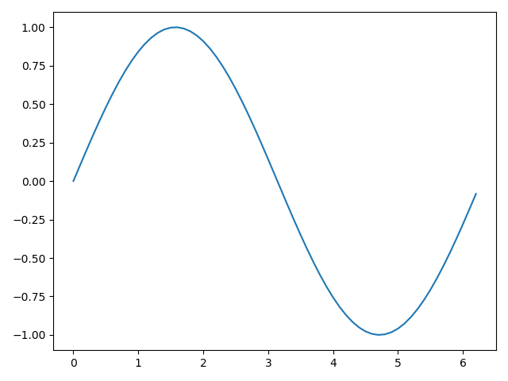
Matplotlib
Plotting
# load numpy and matplotlib
import numpy as np
import matplotlib.pyplot as plt
# generate x and y coordinates
# for points on sine curve
x = np.arange(0, 2*np.pi, 0.1)
y = np.sin(x)
# plot the points using
# matplotlib
plt.plot(x, y)
# call plt.show to make graphics
# appear
plt.show()
Notes:
Matplotlib is a plotting library. In this section give a brief introduction to the matplotlib.pyplot module, which provides a plotting system similar to that of MATLAB.

Slide 28
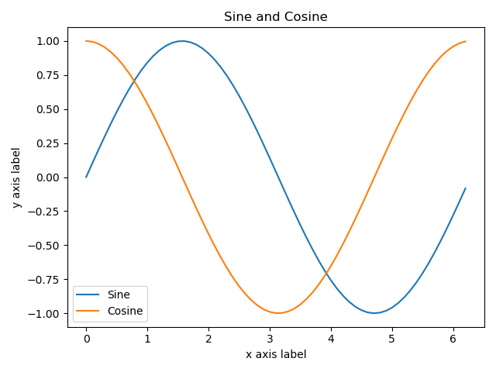
Matplotlib
Plotting
# generate x and y coordinates
# for points both on sine and
# cosine curve
x = np.arange(0, 2*np.pi, 0.1)
y_sin = np.sin(x)
y_cos = np.cos(x)
# add annotations to plot
plt.plot(x, y_sin)
plt.plot(x, y_cos)
plt.xlabel('x axis')
plt.ylabel('y axis')
plt.title('Sine and Cosine')
plt.legend(['Sine', 'Cosine'])
plt.show()

Slide 29
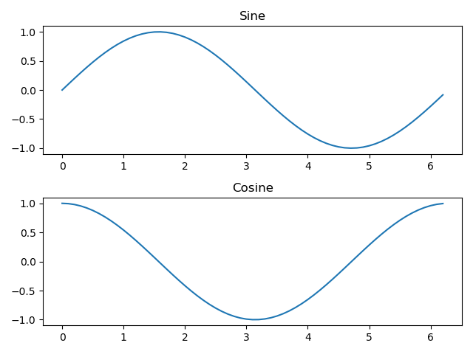
Matplotlib
Plotting
# generate x and y coordinates for points both
# on sine and cosine curve
x = np.arange(0, 2*np.pi, 0.1)
y_sin = np.sin(x)
y_cos = np.cos(x)
# set subplot grid with height 2 and width 1
# set the first subplot as active
plt.subplot(2, 1, 1)
plt.plot(x, y_sin)
plt.title('Sine')
# set the second plot as active
plt.subplot(2, 1, 2)
plt.plot(x, y_cos)
plt.title('Cosine')
plt.show()
More details about pyplot:
https://matplotlib.org/tutorials/introductory/pyplot.html#sphx-glr-tutorials-introductory-pyplot-py

Slide 30
End!

